Slide 1

The Inventory Computing System
for
An Analysis By Example
Continued…

Slide 2
The Context Diagram Process Bubble
0
----
<name>
System
Represents the entire system at the highest level of abstraction.
Examples:
Monetary Counting System
Crazy Haley’s Widget Ordering System
Algonquin College Student Registration System
Note: A Context Diagram is also commonly referred to as a Level 0 Data Flow Diagram
Notes:
Use a numbering system:
Level 0 – 0, Level 1 – 1, 2, 3, 4, 5, Level 2 – 1.1, 1.2
Level 0 – Use <Name> System.
Other levels – use a strong Verb Noun Phrase that explicitly identifies the transformation to be performed on the data – i.e. Process Data means nothing – actually, it means that you don’t understand the problem you are trying to solve.

Slide 3
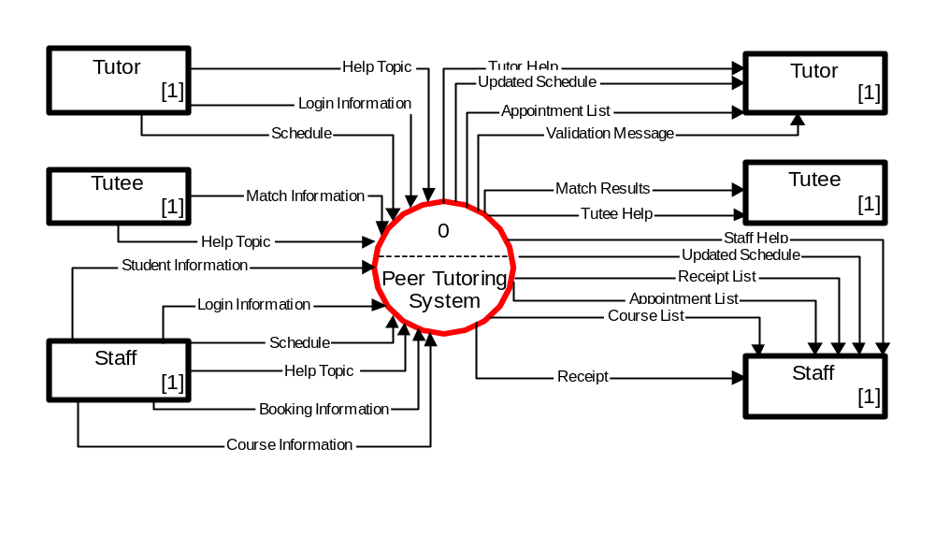
Context Diagram Process Bubble – Example of Usage

Slide 4

The External Entity (External Agent)
External
Entity
A producer or consumer of data that is located outside of the scope of the system being modeled but that interacts with the system modeled.

Slide 5
Modeling Standards – External Entity
<name>
used only on Context diagrams
use a rectangular symbol to model an External Entity
use descriptive, singular nouns or singular noun phrases
use job titles or other physical names, but no proper names
to avoid crossing data flows, it is permissible to duplicate an External Entity on a Context diagram (place a [1] inside the rectangle).
data from/to External Entities must flow only between the External Entity and the system, not between External Entities.
Examples:
Cashier
Administrator
Sensor
Client Network
Server Network
All External Entities must be annotated in the Data Dictionary.

Slide 6
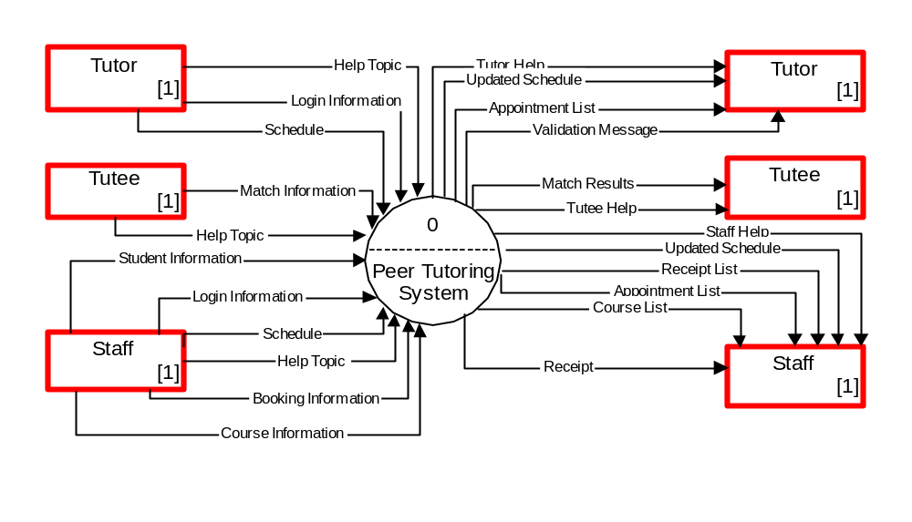
Example of Usage

Slide 7
Data Flows & Control Flows
A data flow is data in motion. It represents an input of data to a process, or the output of data from a process.
  A data flow may also be used to represent the creation, reading, deletion, or updating of data in a data store.
  A composite data flow is a data flow that consists of other data flows.
A control flow represents a condition or nondata event that triggers a process.
  Used sparingly on DFDs.
<data flow name>
<control flow name>
Notes:
Conversion Notes
Most books do not teach “control flows.” The were initially proposed by Paul Ward in his books that extended structured analysis techniques to cover real-time systems. They are especially useful in contemporary information systems analysis because they are as close as structured analysis gets to illustrating “messages” in an object-oriented world.
Teaching Tips
Make sure students do not confuse data flows with flowchart arrows. Flowchart arrows are not named because they merely indicate “the next step.” Data flows pass actual data attributes to and from processes.
CRUD is a useful acronym from the database world to remember the basic data flows as they relate to data stores: Create, Read, Update (or change), and Delete.
One of the most common uses of composite data flows is to combine many reports into a single data flow on a high-level DFD. They can also be used to combine similar transactions on a higher level DFD before differentiating between those flows on lower-level DFDs.
Context diagrams are taught in Chapter 8.
Use case diagrams, an object-oriented analysis tool that also describes interfaces, will be taught in Part Five, Module A.
Context diagrams are taught in Chapter 8.
Use case diagrams, an object-oriented analysis tool that also describes interfaces, will be taught in Part Five, Module A.

Slide 8
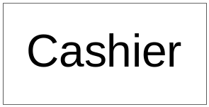
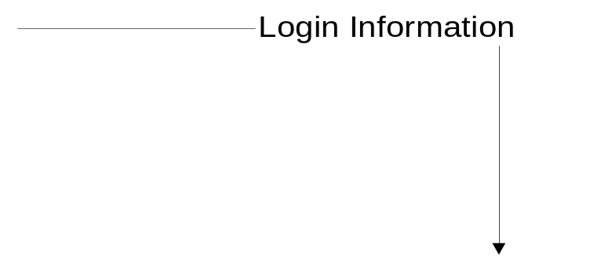
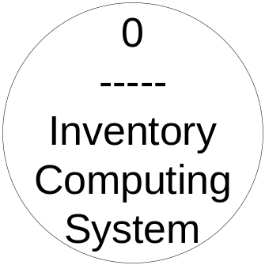
Data Flow Packet Concept
Login Name
Login Password
The data packet concept is critical to analysis. Data that should travel together should be shown as a single data flow called a composite data flow.
Thus Login Information = Login Name + Login Password is a composite data flow that consists of two data flows.
See course text page 321.
Notes:
No additional notes

Slide 9
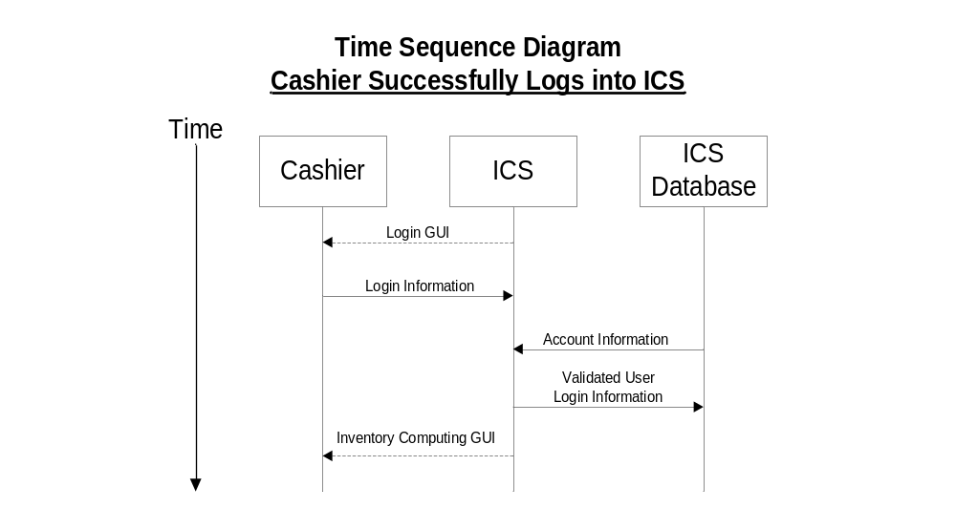
Creating DFDs from Use-Cases/TSDs
System Boundary Data
Internal Data
Notes:
Here’s a summary of where we are now.

Slide 10
Context Diagram
Note that the depicted data is exactly identical to the data illustrated in the TSDs that we previously discussed. This is called correlation of data and is paramount to the quality of an analysis of a system!

Slide 11
Looking Inside the System
Level 1..n DFD Process Bubbles
<number>
----
<strong verb
-noun phrase>
A data transformer
(changes input to output)
Levels 1..n illustrate WHAT the system actually must do to transform data.
Course text refers to these as Event Diagrams – we will use the term Process Bubble
Examples: Compute Taxes, Calculate Area,
Format Report, Display Graph
All processes must have accompanying narratives.
Notes:
Use a numbering system:
Level 0 – 0, Level 1 – 1, 2, 3, 4, 5, Level 2 – 1.1, 1.2
Level 0 – Use <Name> System.
Other levels – use a strong Verb Noun Phrase that explicitly identifies the transformation to be performed on the data – i.e. Process Data means nothing – actually, it means that you don’t understand the problem you are trying to solve.

Slide 12
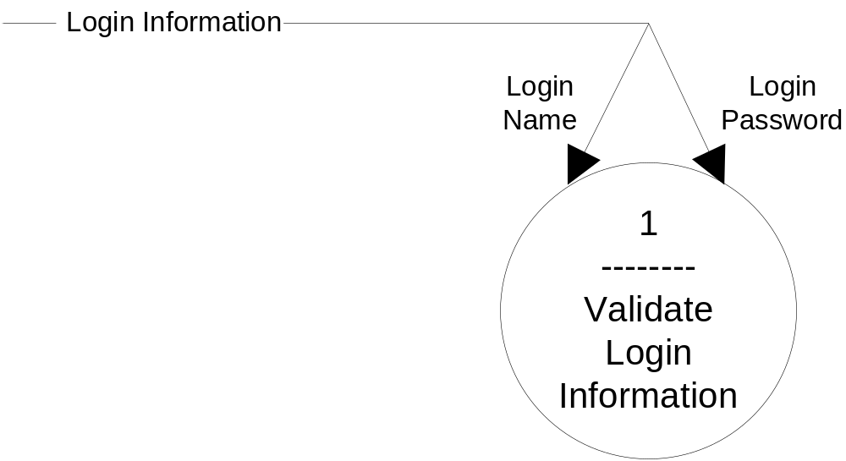
The First Level One DFD
System Boundary Data
Note the diverging data flow (text page 365/333)

Slide 13
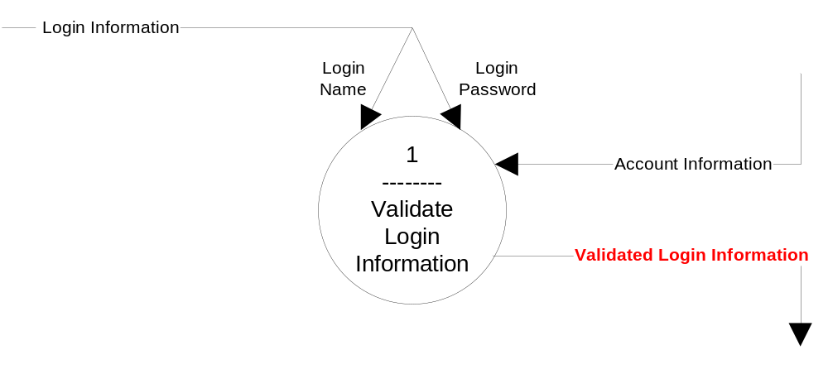
The First Level One DFD
System Boundary Data
Internal Data
Note the name change from Validated User Login Information! On first diagram

Slide 14
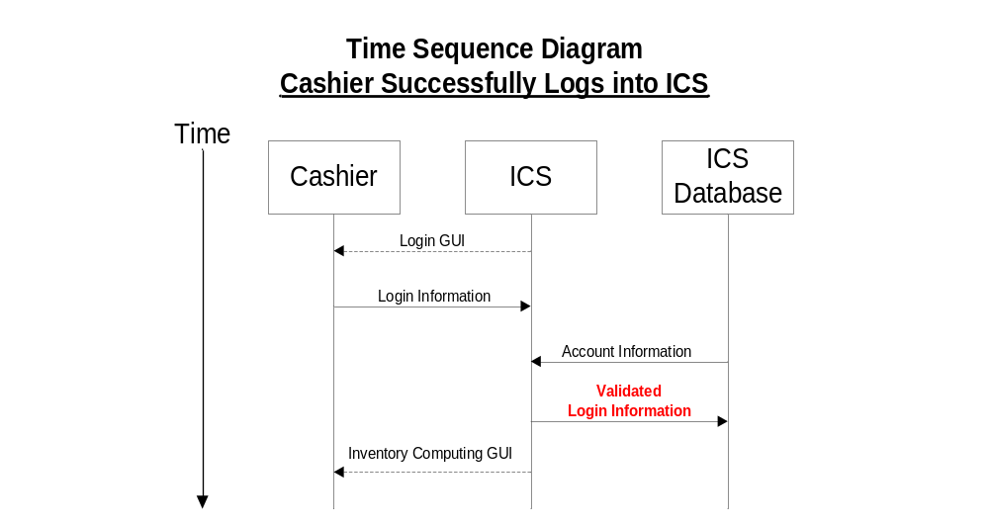
Creating Data Stores from Use-Cases
Internal Data Stores must be identified
Notes:
Here’s a summary of where we are now.

Slide 15

Data Stores
A data store is an inventory of data.
  Model the storage of business’s data
  Frequently implemented (after design phase) as a file or database.
  A data store is “data at rest” compared to a data flow that is “data in motion.”
  Data stores depicted on a DFD store all instances of data entities (depicted on an ERD)
Data Store
Notes:
Teaching Tips
Emphasize that a data store contains all instances of a data entity (from the data model). That is why data store names are plurals (as contrasted to data entity names that are singular).
Although we don’t prefer it, some analysts designate a data store to contain all instances of several entities and relationships from a data model. For example, an ORDERS data store might include all instances of the data entities ORDER and ORDERED PRODUCT, and all instances of the relationship between ORDER and ORDERED PRODUCT—We prefer the simplicity of representing each data entity from the data model as its own data store on the process models.
Emphasize that because data stores are shared resources available to many processes, it is acceptable to duplicate them on several DFDs—The duplication does NOT indicate redundant storage (on logical DFDs); it merely represents the sharing of the data store by several processes.

Slide 16
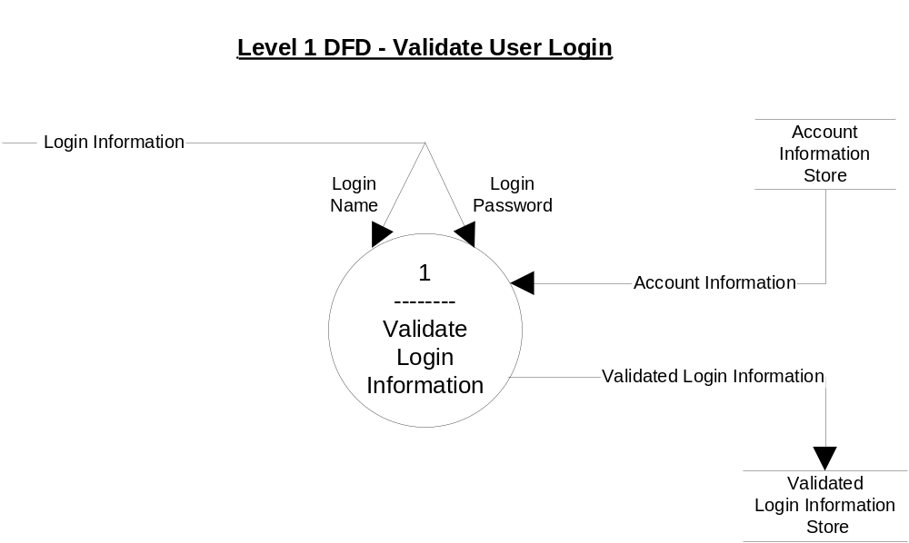

Slide 17
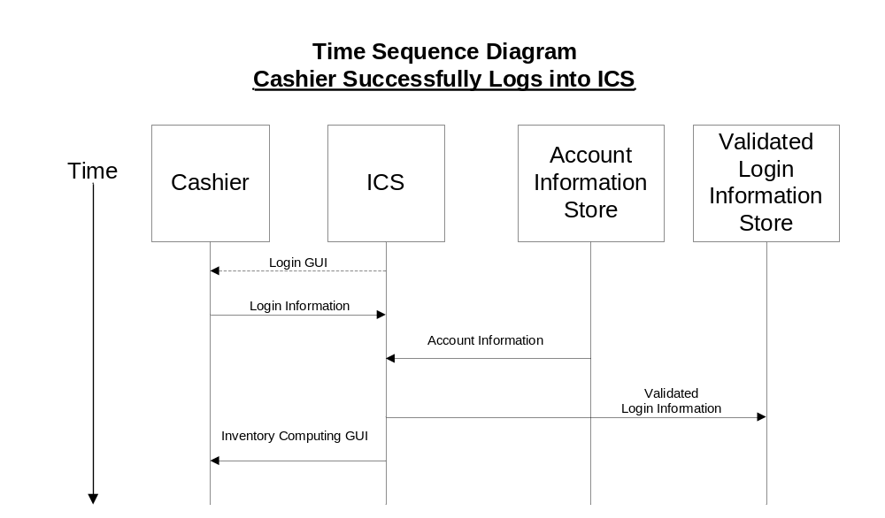
Modified Use-Case/TSD

